Slide 1
IT Infrastructure: Hardware and Software
Notes:
There are two video cases and five instructional videos for this chapter:
Case 1 Hudson’s Bay Company and IBM: Virtual Blade Platform
Case 2 Salesforce.com: SFA on the iPhone and iPod Touch
Instructional Video 1 Google and IBM Produce Cloud Computing
Instructional Video 2 IBM Blue Cloud is Ready-to-Use Computing
Instructional Video 3 What the Hell is Cloud Computing?
Instructional Video 4 What is AJAX and How Does it Work?
Instructional Video 5 Yahoo’s FireEagle Geolocation Service

Slide 2
LEARNING OBJECTIVES
What are the components of IT infrastructure?
What are the major computer hardware, data storage, input, and output technologies used in business?
What are the major types of computer software used in business?
What are the most important contemporary hardware and software trends?
What are the principal issues in managing hardware and software technology?
What is the meaning of Moore’s Law

Slide 3
IT Infrastructure: Computer Hardware
Infrastructure Components
IT infrastructure: provides platform for supporting all information systems in the business
Computer hardware
Computer software
Data management technology
Organizes, manages, and processes business data concerned with inventory, customers, and vendors
Networking and telecommunications technology
Technology services
E.g., consultants for systems integration with legacy systems
Notes:
It may be hard to students to think of a business having “computer infrastructure.” A good parallel is the infrastructure of a building which would include the electrical and plumbing systems, along with a telephone network. Students are familiar with these types of infrastructure. Like these other kinds of infrastructure, IT infrastructure may not be visible to the casual employee, but it plays a vital role in the life of the business. Without it, there would be no business typically.

Slide 4
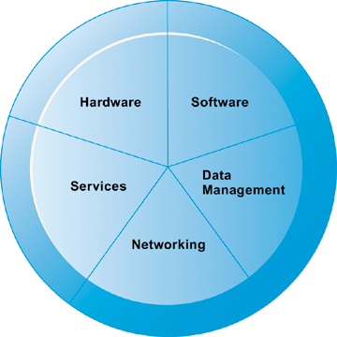
IT Infrastructure: Computer Hardware
IT Infrastructure Components
A firm’s IT infrastructure is composed of hardware, software, data management technology, networking technology, and technology services.
Figure 4-1

Slide 5
Moore’s Law
Moore’s Law predicts that the number of transistors fitting on a computer chip will double every one and a half to two years.
This prediction about density also captures advances in processing speed, storage capabilities, cost, and other component features.
Processing power and speed and storage capabilities have increased exponentially as the cost of computing devices has decreased.

Slide 6
IT Infrastructure: Computer Hardware
Types of Computers
Computers come in different sizes with varying capabilities for processing information.
FLOPS (Floating point operations per second)
Smartphones, netbooks, e-book readers
Today’s smartphones are far more powerful than the early PCs of the 1980s
PCs
Workstations
More powerful mathematical and graphics-processing capabilities than a PC
Used primarily for advanced design or engineering work requiring powerful graphics or computational capabilities.
Notes:
Most students do not think of their cell phones as computers. Yet cell phones have powerful, energy-efficient processor chips that use very little power, an operating system, and application software (including games). Of course smartphones like iPhone and Blackberrry and others truly are computer systems that also are telephones. Today’s smartphones are far more powerful than the early PCs of the 1980s.
90 percent of the billion cell phones shipped each year use some version of ARM (Advanced RISC Machine) chips, licensed by ARM Inc. and manufactured by many firms. For instance, Apple’s latest 3G iPhone uses an ARM 11 chip with a 600 mghz processor speed, and uses only .45 milliwatts of power (compared to a typical laptop dual core mobile Intel processor that uses 25 watts—about 500 times more power consumption). Smartphones do not need fans. Cellphones do not use power hungry hard drives but instead use flash memory chips with storage of up to 32 megabytes. Whereas the latest Energy Star 4 laptop disk drives consume 500 milliwatts at idle, and 1 watt writing and reading, flash memory chips consume about 50 milliwatts writing and reading data, (twenty times less power).

Slide 7
IT Infrastructure: Computer Hardware
Types of Computers
Servers:
Type of midrange computer.
Support computer network, sharing files and resources.
Provide hardware platform for e-commerce.
Mainframes:
Large-capacity, high-performance computer that can process large amounts of data very rapidly
E.g., used by airlines for thousands of reservations per second
Mainframes are still a major revenue and profit source for IBM, one of the last large-scale commercial manufacturers of mainframe computers. They are used often as huge Web servers where they are more efficient than tens of thousands of PCs in processing large volumes of records
Notes:
Ask students if they have heard about, or know about, servers and mainframes. Some students in your class might have direct experience working with servers as network administrators, or as technicians. Most will not have experience with mainframe computers. Be sure to point out that mainframes are still a major revenue and profit source for IBM, one of the last large-scale commercial manufacturers of mainframe computers. They are used often as huge Web servers where they are more efficient than tens of thousands of PCs in processing large volumes of records.

Slide 8
IT Infrastructure: Computer Hardware
Types of Computers
Supercomputer:
More sophisticated computer used for tasks requiring extremely rapid and complex calculations with thousands of variables, millions of measurements
Used in engineering, scientific simulations, military/weapons research, weather forecasting
Grid computing: Video
Power of geographically remote computers connected into single network to act as “virtual supercomputer”
Notes:
In the past, supercomputers used custom designed chips (processors) and RAM memory chips, all very densely packed, to achieve very high speeds of computation. The most common, and some of the largest, supercomputers today are often made up of tens of thousands of Intel Pentium or multicore processors which are relatively inexpensive. Google has one of the largest civilian computing systems in the world that deals with supercomputer-level amounts of data, and yet is built from nearly one million PCs working together.
Grid computing is similar to utility computing in the sense of sharing the resources of many computers. But grid computing usually involves teaming up remote computers to focus on solving the same problem or parts of the same task. Students can participate in a kind of Internet grid computing program called SETI (http://setiathome.berkeley.edu/). SETI@home is a scientific experiment that uses Internet-connected computers in the Search for Extraterrestrial Intelligence (SETI). Students can participate by running a free program that downloads and analyzes radio telescope data.

Slide 9
IT Infrastructure: Computer Hardware
Types of Computers
Client/server computing:
Form of distributed computing
Splits processing between “clients” and “servers”
Clients: user point of entry
The user generally interacts directly only with the client portion of the application, often to input data or retrieve data for further analysis.
Servers: store and process shared data and perform network management activities
Notes:
You may want to spend some time explaining carefully client/server computing because it is the dominant model of computing and has been since the 1990s. The Web is a very large example of client/server computing. The client/server model of computing is based on inexpensive PC microprocessors. Server architecture allows data centers to scale up as need by simply adding more servers (or increasing the processing power of existing servers by moving to dual and quad core processors). Clients are the interface between system and user.

Slide 10
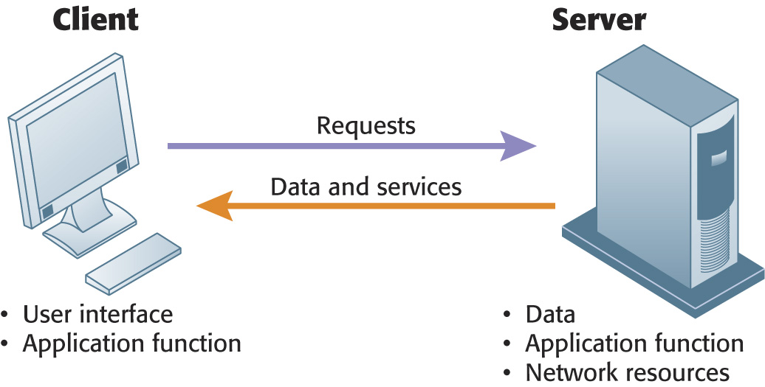
IT Infrastructure: Computer Hardware
Client/Server Computing
In client/server computing, computer processing is split between client machines and server machines linked by a network. Users interface with the client machines.
Figure 4-2
Notes:
You might point out to students the confusion that results from the word “server.” A server is a physical computer. It’s also the software that runs on that computer which “serves” user requests. The intended meaning often comes from the context in which it is used. If someone says we had to “purchase a number of servers,” it usually means the purchase of computers. When people say “the server is down” they usually mean the computer is down.

Slide 11
IT Infrastructure: Computer Hardware
Storage, Input, and Output Technology
Primary secondary storage technologies
Magnetic disk:
Hard drives, USB flash drives
RAID: can package hundreds of drives for massive storage requirements
Optical disks
CD-ROM, CD-RW, DVD
Magnetic tape
Storage networking: SANs
Connect multiple storage devices on a separate high-speed network dedicated to storage
Notes:
The cost of digital storage has fallen exponentially along with the cost of computing. Today, an 8 gigabyte USB “Flash Drive” costs about $20. You might ask students what impact they think this might have on the amount of digital information stored in corporations. Or ask students how many gigabytes of information they use to store photos, music, videos, podcasts, and other digital material. On average in 2010, Americans consume 34 gigabytes of digital information a day.

Slide 12
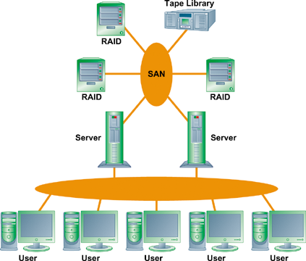
IT Infrastructure: Computer Hardware
A Storage Area Network (SAN)
SANs are an effort by corporations to reduce storage costs, manage information, increase flexibility, and provide near-certain backup. One of the major worries of business firms is losing customer or other digital data. Extraordinary efforts are taken to make redundant copies of digital information, and placing it on separate secure servers, even remote servers in separate facilities.
A typical SAN consists of a server, storage devices, and networking devices, and is used strictly for storage. The SAN stores data on many different types of storage devices, providing data to the enterprise. The SAN supports communication between any server and the storage unit as well as between different storage devices in the network.
Notes:
SANs are an effort by corporations to reduce storage costs, manage information, increase flexibility, and provide near-certain backup. One of the major worries of business firms is losing customer or other digital data. Extraordinary efforts are taken to make redundant copies of digital information, and placing it on separate secure servers, even remote servers in separate facilities.

Slide 13
IT Infrastructure: Computer Hardware
Storage, Input, and Output Technology
Input devices:
Gather data and convert them into electronic form.
Keyboard
Computer mouse
Touch screen
Optical character recognition
Magnetic ink character recognition
Pen-based input
Digital scanner
Audio input
Sensors
Notes:
Ask if students can think of other ways information gets into computers. How about digital cameras and cell phone cameras?

Slide 14
IT Infrastructure: Computer Hardware
Storage, Input, and Output Technology
Output devices:
Display data after they have been processed.
Monitor
Printer
Audio output
Information systems collect and process information in one of two ways.
Batch processing: transactions stored for predefined amount of time, then processed as group
Online processing: transactions processed immediately
Notes:
Students may be unfamiliar with batch processing. It’s used when there are large numbers of nearly identical types of transactions and where there is no need for an immediate online updating of records. Consumer banking transactions are usually performed in batch mode at night, and accounts are current and updated by morning. In contrast, an online shopping cart needs to be updated whenever the customer changes his/her order.

Slide 15
IT Infrastructure: Computer Hardware
Contemporary Hardware Trends
The emerging mobile digital platform
Based on new handheld hardware like cell phones, netbooks, and tablet computers. A new “platform.”
Wireless communications through 3G cell networks and Wi-Fi.
New software apps.
Nanotechnology: video
Uses individual atoms and molecules to create computer chips and other devices that are thousands of times smaller than current technologies permit.
Nanotechnology shrinks the size of transistors down to the width of several atoms.
Notes:
Talk to students about how they are using their cell phones. Are they listening to online radio stations, streaming music and videos, or mostly just texting? Ask them to think about how this new mobile platform might influence how a business is run, or how it is managed.

Slide 16
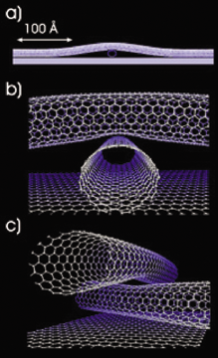
IT Infrastructure: Computer Hardware
Examples of Nanotubes
Nanotubes are tiny tubes about 10,000 times thinner than a human hair. They consist of rolled up sheets of carbon hexagons, have potential uses as minuscule wires or in ultrasmall electronic devices, and are very powerful conductors of electrical current.
Figure 4-5
Notes:
Nanotechnology is the study of the controlling of matter on an atomic and molecular scale. Generally, nanotechnology deals with structures of the size 100 nanometers or smaller. Nanotechnology is used to create transistors of the tiny size previously mentioned. Can students describe any other applications of this type of technology (for example, medical)?

Slide 17
IT Infrastructure: Computer Hardware
Contemporary Hardware Trends
Cloud Computing: video
A model of computing in which firms and individuals obtain computing resources over the Internet
Cloud infrastructure as a service
customers use processing, storage, networking, and other computing resources from cloud service providers to run their information systems.
Cloud platform as a service
customers use infrastructure and programming tools hosted by the service provider to develop their own applications.
Cloud software as a service
customers use software hosted by the vendor.
Top Free Cloud Computing Software
Notes:
Both grid computing and cloud computing allow organizations to optimize their use of resources in new ways. Grid computing allow corporations to take advantage of spare computing power in the form of networked virtual supercomputers, and cloud computing allows organizations to avoid the expenses of maintaining their own hardware and software, relying on the cloud instead. Refer students to the Cloud Computing Learning Track on the Web site.
Most students have unwittingly used autonomic computing: whenever Microsoft or other software company updates your PC online automatically it is a kind of autonomic computing. A more pure form would be if your operating system could call out to the cloud when it faced a shutdown and ask for help in restoring its functionality.

Slide 18
Cloud Advantages
Eliminates need for large up-front capital investments in systems
Eliminates lengthy implementations on corporate computers
Low cost subscriptions; no expensive licensing and maintenance fees
No hardware for subscribers to purchase, scale, and maintain
No operating systems, database servers or applications servers to install
No consultants and staff
Accessible via standard Web browser with behind-the-scene software updates
Better scalability, eliminate cost and complexity of managing multiple layers of hardware and software

Slide 19
Cloud Disadvantages
May not be attractive to larger companies for their application needs
Responsibility of data storage and control is in the hands of the provider
Security risks may increase and open vulnerabilities to data maintenance
System reliability issues
Users dependency on the cloud computing provider

Slide 20
IT Infrastructure: Computer Software
Cloud Computing Platform
In cloud computing, hardware and software capabilities are provided as services over the Internet. Businesses and employees have access to applications and IT infrastructure anywhere at any time using an Internet-connected device.
Figure 4-6
Notes:
Salesforce.com is often listed as a cloud computing pioneer, but most of the largest tech companies have cloud computing operations.

Slide 21
Virtualization
Autonomic computing:
Development of systems that can configure themselves, heal themselves; e.g., self-updating antivirus software

Slide 22
IT Infrastructure: Computer Hardware
Contemporary Hardware Trends
Virtualization: video
Process of presenting a set of computing resources so they can be accessed in ways that are unrestricted by physical configuration or geographic location
IBM’s mainframes run tens of thousands of separate instances of Windows or Linux on a single large mainframe computer, giving users the impression they have their own dedicated computer
Server virtualization: running more than one operating system at the same time on single machine.
Virtual memory is memory which fools the processor into thinking it is hardware memory but in fact is memory located on a hard drive.
Notes:
The term “virtualization” is so widely used that it can be confusing. Virtualization has an “as if” quality to it. There are virtual machines that are software “machines” which act as if they were a real physical computer (executes instructions like the physical machine it emulates). IBM’s mainframes run tens of thousands of separate instances of Windows or Linux on a single large mainframe computer, giving users the impression they have their own dedicated computer. Server computers can be virtualized to run multiple instances of an operating system also giving users the feeling they have their own computer. Virtual memory is memory which fools the processor into thinking it is hardware memory but in fact is memory located on a hard drive.

Slide 23
IT Infrastructure: Computer Hardware
Contemporary Hardware Trends
Multicore processors:
Integrated circuit with two or more processors
Enhanced performance, reduced power consumption, and more efficient simultaneous processing of multiple tasks
Notes:
Multicore processors are the major way computer manufacturers today can increase speed and power. When all processing is done by a single chip, power leakage and heat increase as processor speed is increased. These limitations are avoided by spreading the load across two or more processors operating at slower speeds but which together can get the job done faster than a single high speed chip.

Slide 24
IT Infrastructure: Computer Software
Operating System Software
The software that manages and controls the computer’s activities
PC operating systems and graphical user interfaces
GUIs
Windows XP, Windows Vista, and Windows Server 2003
UNIX
Linux
Open-source software
Notes:
PC operating systems create the user interface, like Windows or Macintosh OS. This interface has evolved from a text command interface to a mouse-based graphical user interface to current touch screen interfaces found on some PCs and smartphones. Most students do not know their cell phone has an operating system. On the blackboard, make a list of the “resources” that a cell phone or smartphone has to manage. Managing these resources is one function of the operating system, along with creating the use interface.

Slide 25
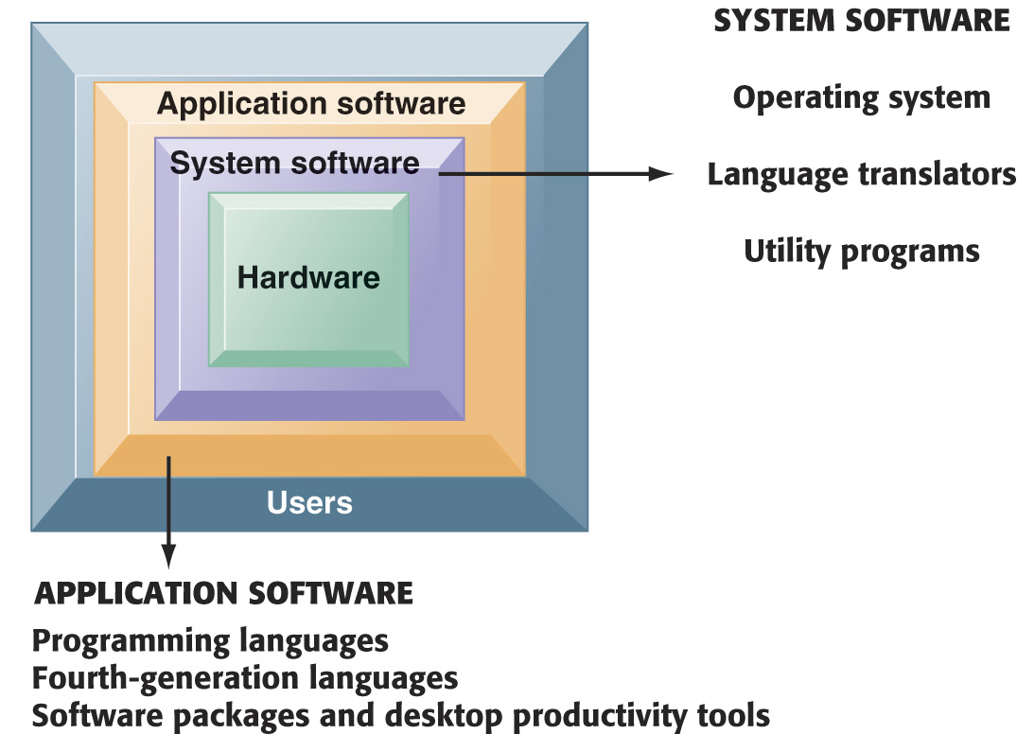
IT Infrastructure: Computer Software
The Major Types of Software
The relationship among the system software, application software, and users can be illustrated by a series of nested boxes. System software—consisting of operating systems, language translators, and utility programs—controls access to the hardware. Application software, including programming languages and “fourth-generation” languages, must work through the system software to operate. The user interacts primarily with the application software.
Figure 4-7
Notes:
You might ask students why a Microsoft application like Word cannot be installed on both PCs and Macintosh computer? Why is it that users are forced to buy different software application software for different devices? A part of the answer is the close interdependency of hardware, operating systems, and application software.

Slide 26
IT Infrastructure: Computer Software
Software for the Web: Java, AJAX, and HTML
Java:
Operating system-independent, processor-independent, object-oriented programming language
AJAX:
Allows a client and server to exchange data behind the scenes to avoid reloading a Web page after each change
Hypertext markup language (HTML):
Page description language for specifying how elements are placed on a Web page and for creating links to other pages and objects
Notes:
Java, and the Java Virtual Machine, is ubiquitous across the Web. It is useful because it allows developers to write an application once in Java, and then be assured it will work on any Java-enabled machine.
Google Maps is probably the best-known Ajax application. Functionally, it offers some great advances over conventional map Web sites:
The user can pan and zoom and change location without the page being reloaded.
Many students probably do not know that you can see the HTML code of any Web page by the View/Page Source menu in Mozilla Firefox. You could demonstrate this during class.

Slide 27
IT Infrastructure: Computer Software
Web 2.0 Video
Web services:
Software components that exchange information with one another using universal Web communication standards and languages
It’s a “messaging system” which allows diverse computing applications in a firm to communicate data with one another without extensive integration of the constituent applications (which tends to be very expensive)
XML (extensible markup language)
SOAP (simple object access protocol)
WSDL (Web services description language)
UDDI (universal description, discovery, and integration)
Service oriented architecture (SOA)
In a service-oriented architecture, various applications provide “services” (data) on request to other applications needing data.
SOA is a major alternative to installing large scale enterprise systems.
Notes:
Web services is an approach to building enterprise applications. It’s a “messaging system” which allows diverse computing applications in a firm to communicate data with one another without extensive integration of the constituent applications (which tends to be very expensive). In a service-oriented architecture, various applications provide “services” (data) on request to other applications needing data. SOA is a major alternative to installing large scale enterprise systems.
Emphasize that SOA is a method of developing infrastructure using Web services with an eye toward creating applications that draw data from several underlying (usually older programs). All programs are built or redesigned to provide certain information (services) to all other programs. With SOA, developers incorporate each individual service into an application that successfully meets the needs of the organization.

Slide 28
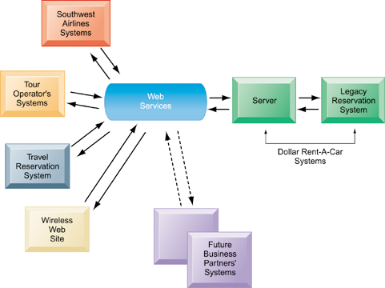
IT Infrastructure: Computer Software
How Dollar Rent-A-Car Uses Web Services
Dollar Rent-A-Car uses Web services to provide a standard intermediate layer of software to “talk” to other companies’ information systems. Dollar Rent-A-Car can use this set of Web services to link to other companies’ information systems without having to build a separate link to each firm’s systems.
Figure 4-9
Notes:
Dollar Rent-a-Car is an excellent example of how computer applications, some owned by different firms, can work together to provide a single environment for customers and users.

Slide 29
IT Infrastructure: Computer Software
Software Trends
Open Source Software
Linux, Apache
Cloud Computing
Google Apps, Office Web Apps
Mashups are Web applications that combine content or data from multiple online sources into new Web applications
Contents are continually updated
Content for mashups often comes from Web feeds and Web services
Amazon uses mashup technologies to aggregate product descriptions with partner sites and user profiles, commentaries, and images.
Travel sites, such as Travelocity, Kayak, Matador, and Travature, integrate standard content (such as airfare search engines, travel guides, maps, and hotel reviews) with comments, ratings, and images from users.
Software as a Service (SaaS)
Salesforce.com
Notes:
Ask students to help you put together a list of really interesting software apps they have discovered or used in the last few months.

Slide 30
Managing Hardware and Software Technology
Capacity planning
Process of predicting when hardware system becomes saturated
Ensuring firm has enough computing power for current and future needs
Factors include:
Maximum number of users
Impact of current, future software
Performance measures
minimum response time for processing business transactions.
Throughput
Scalability: ability of system to expand to serve large number of users without breaking down
Organizations must ensure they have sufficient computer processing, storage, and network resources to handle surging volumes of digital transactions and to make such data immediately available online.
Notes:
One of the problems that firms face is the holidays when user demand for online services explodes, but then recedes after the holidays to a normal background level. Firms are forced to buy additional infrastructure to handle peak loads, which then sits idle after the holiday is over. One solution is to use cloud-based services to handle the peak loads of your firm, essentially renting extra capacity as needed. This solves the peak load problem and a part of the scalability problem—with cloud computing services you expand as needed without huge financial outlays.

Slide 31
Managing Hardware and Software Technology
Total Cost of Ownership (TCO) model
Used to analyze direct and indirect costs to help determine the actual cost of owning a specific technology
Direct costs: hardware, software purchase costs
Indirect costs: ongoing administration costs, upgrades, maintenance, technical support, training, utility, and real estate costs
Hidden costs: support staff, downtime, additional network management
Five year TCO for computing equipment can be 3 – 10 times the original purchase price
TCO can be reduced through increased centralization, standardization of hardware and software resources.
Notes:
Most students think of the “cost of computing” as the cost of the computer and the software. You could ask students to help you put together a list of all the additional costs that consumers face when purchasing a computer.

Slide 32
Components of TCO for a IT System
Hardware acquisition | Purchase price of hardware including computers, terminals, storage and printers
Software acquisition | Purchase or license of software for each user
Installation | Cost to install hardware and software
Training | Cost to train IT staff and end-users
Support | Cost to provide ongoing technical support; help desks, documentation etc
Infrastructure | Cost to acquire, maintain and support related infrastructure such as networks and specialized equipment (including storage and backup units)
Downtime | Lost productivity if hardware or software failures cause the system to unavailable for processing user tasks
Space and energy | Real estate and utility costs for hosing and providing power for the technology

Slide 33
Strategies for Creating and Deploying Software
Commercial off-the-shelf software solutions are ready-made and available for licensing or sale to the general public
Off-the-shelf software systems that cannot be modified to meet the specific needs of a particular organization are sometimes called turn-key systems or software
Custom software development describes how an organization develops and builds software tailored specifically to its needs.

Slide 34
Strategies for Creating and Deploying Software continued
Using technology service providers
Outsourcing
Using external provider to:
Run networks.
Host, manage Web site(s).
Develop software (offshore software outsourcing).
Manage IT infrastructures.
Requires Service Level Agreements (SLAs)
a formal contracts between customers and service providers that define the specific responsibilities of the service provider and the level of service expected by the customer.
Notes:
One common answer to reducing the cost of computing hardware and software is to move the work off-shore to low wage countries like India and China. Thousands of U.S. and European firms outsource their programming work to low-wage countries. Even more firms outsource programming, systems analysis and design, and consulting work to onshore domestic firms. Nevertheless, computer and network jobs are abundant in the United States in part because more systems are being built than ever before (in part because building systems is less expensive than ever). As the costs of developing systems decline, the demand for systems grows stronger.

Slide 35
Advantages of Outsourcing
Allows a business to concentrate on its core competencies rather than focusing on technology issues.
Instead of purchasing all the necessary hardware and software for hosting a Web site, a business can use a Web hosting service that maintains a large Web server
Outsourcing custom software development or maintenance to outside firms benefits a company because it won’t have to hire programmers, analysts, and managers with the necessary skills.
An outsourcer often has the technical and management skills to do the job better, faster, and more efficiently.
Even though it’s often cheaper to outsource the maintenance of an IT infrastructure and the development of new systems to external vendors, a business must weight the pros and cons carefully.

Slide 36
Managing Hardware and Software Technology
Using cloud services
Small businesses “rent” infrastructure from another firm to avoid expenses of maintaining hardware and software on their own.
Off-loading peak demand to remote data centers
Amazon Markets http://www.amazonservices.com/
Amazon provides cloud services to major business firms, and also to thousands of small merchants who want to use Amazon software to sell their goods and services.
Managing mobile platforms
Balancing gains in productivity from using mobile devices with expenses of equipping employees with these devices
TCO for wireless devices ranges from $1,000 to $3,000
Notes:
One way students can use cloud services is through Amazon Markets http://www.amazonservices.com/. Amazon provides cloud services to major business firms, and also to thousands of small merchants who want to use Amazon software to sell their goods and services. Take students to the Amazon site to demonstrate some of its capabilities.

Slide 37
Managing Hardware and Software Technology
Managing software localization for global business
Local language interfaces
English not typically standard at middle, lower levels
Interfaces are complex: menu bars, error messages, online forms, search results, and so on
Differences in local cultures
Differences in monetary structure
Differences in business processes
All of these factors add to TCO of using technology service providers
http://www.ricintl.com Language Scientific
firms are translating their systems and localizing them (which is more than just translation).
Notes:
If you are operating in a global environment you can’t assume your employees will be able to understand English interfaces. An interesting niche business is software translation services. Do a search in class on “localization services” or go to http://www.ricintl.com/ Ric International translation services to illustrate for students how firms are translating their systems and localizing them (which is more than just translation).

